Slide 1
Database developer stories
How not to make your Dba cry as a back-end engineer

Slide 2


Slide 3


Slide 4


About me
Software Engineer at LogMeIn
Former full-stack engineer
Hired as a database engineer
Currently a back-end engineer
One wife
Two kids

Slide 5
Q/A

Slide 6



Roles
Back-End developer
Database Engineer
DBA
Creates back-end code
You are lucky if you have one
Wakes up at 2am

Slide 7
Stories

Slide 8
Warmup Select *
Demo
Notes:
Demo Steps:
Create a very simple user table
Add sample data (developer machine version)
Select * . Point out it gives back the password hash
Add column companyId
Select * . User listing page. Point out we need only UserName and Id
Add column external token
Select * . User listing page now gives back our tokens as well.
Point out token will be small on dummy data and large on the live server

Slide 9
Select *
Code review
Code analyzers
Genius method (Demo)
Notes:
Genius method: add computed column: 1/0

Slide 10
Performance optimization DEMO

Slide 11
Creating? Indexes

Slide 12
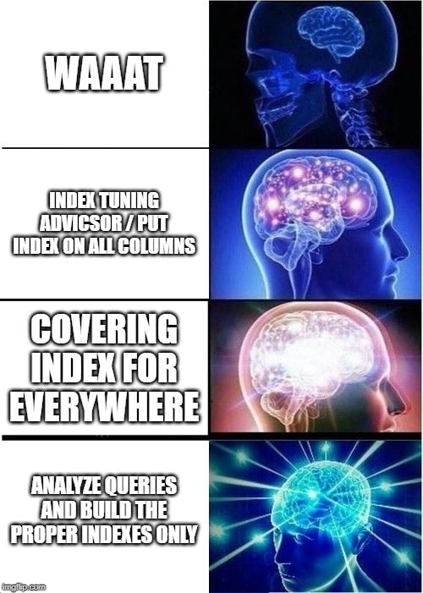
Thinking in indexes

Slide 13
Data types

Slide 14
Data types – Integer types
Back-End | Database
int | int not null
int? | int null
int | int null
int? | int
long | int
int | bigint
usigned long | Waaat?

Slide 15
Data types – strings – C# variable
string email = “zsolt.miskolczi@logmein.com”;

Slide 16
Data types – strings – TSQL variable
declare @Email nvarchar(100) = ‘zsolt.miskolczi@logmein.com’

Slide 17
Data types – strings – table definition
create table Users (
…
Email nvarchar(100) null
...
)
go
insert into Users (Email) values (‘zsolt.miskolczi@logmein.com’)

Slide 18
Data types – strings – C# property to JSON
[Required]
public string Email { get; set; }
this.Email = “zsolt.miskolczi@logmein.com”;

Slide 19
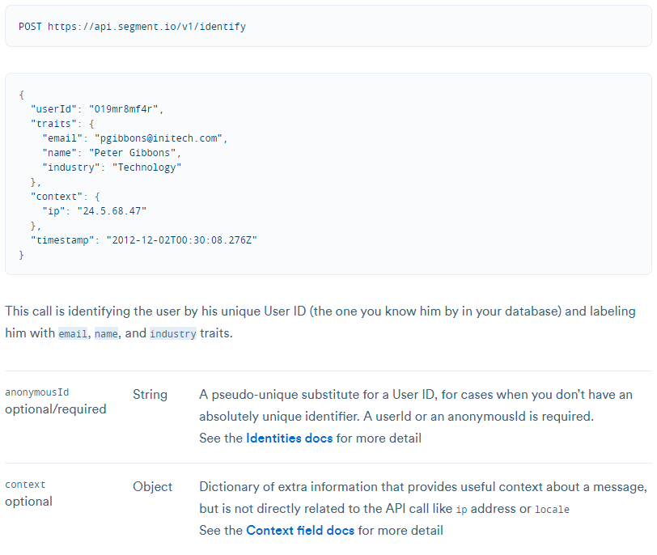
Data types – public APIs

Slide 20
Data types – public APIs
Relational database is not a Document Db.
Again, every property has
Type
Length
Nullability
Normalization is some magic thing that still exists

Slide 21
Data types – public APIs
Notes:
Demo1
Create procedure that iterates throught the whole table
Tell the procedure background (it is already performace optimized)
SP fix: EXISTS clause
Demo2: Index: WAAAAT?
Example query: search user by UserName
Show it scans the whole table
Create an index
Telling the original solution (Buy a new Server :D)

Slide 22
ORM

Slide 23

The Good, The Bad and the Ugly
Good
Bad
Ugly
Saves coding time
People become lazy
Generated query

Slide 24
ORM tips
Do not forget lazy load
Database state can be changed after you queried your data
You can work in batches
If you want to persist anything in a for loop, think it twice
Check if your ORM supports batch modifications
Changing data type is a pain in the ass
Thumb rule: ORM is for SQL is the same as TypeScript to JavaScript. Nothing changes under the hood

Slide 25
ORM questions. What happens if we want to …
modify column type?
modify the column type if it is a foreign key?
add a new column with default value?
…

Slide 26
Evolving web sites VS Databases

Slide 27
How to roll back?
Web site: upload a new version
Database:
Figure out a way to keep your data consistent
What happens to data that already has been modified?

Slide 28
Close to end

Slide 29
Fresh story Rename columns, modify column order

Slide 30

Conversation

Slide 31
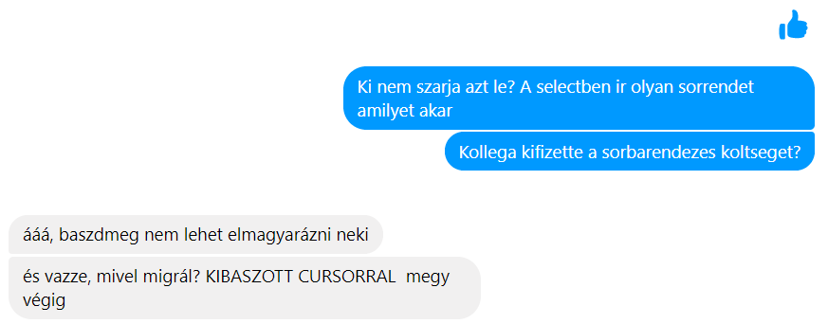
Conversation

Slide 32

Conversation

Slide 33

Conversation

Slide 34
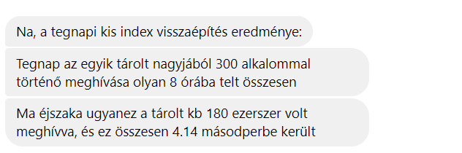
Conversation

Slide 35
How to do? Rename columns, modify column order

Slide 36
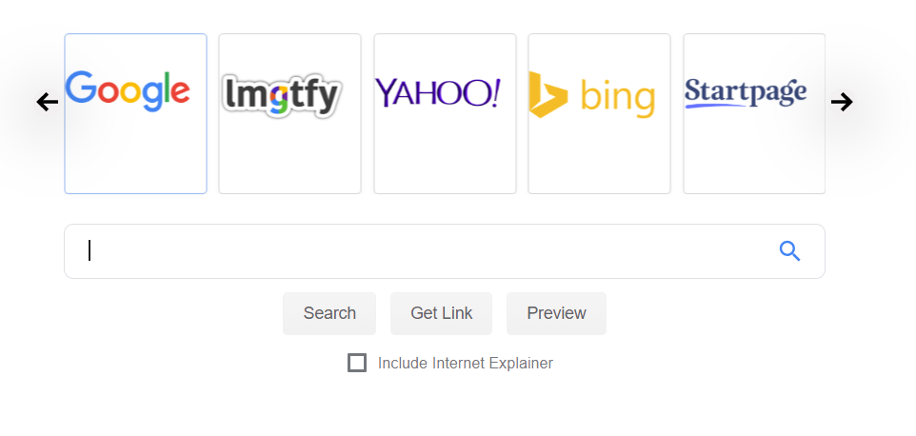
Let’s find a solution

Slide 37
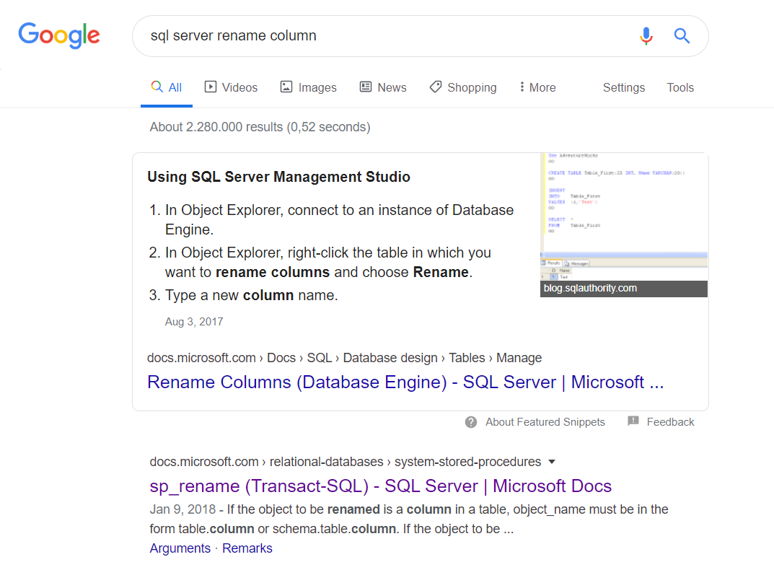
Rename column

Slide 38
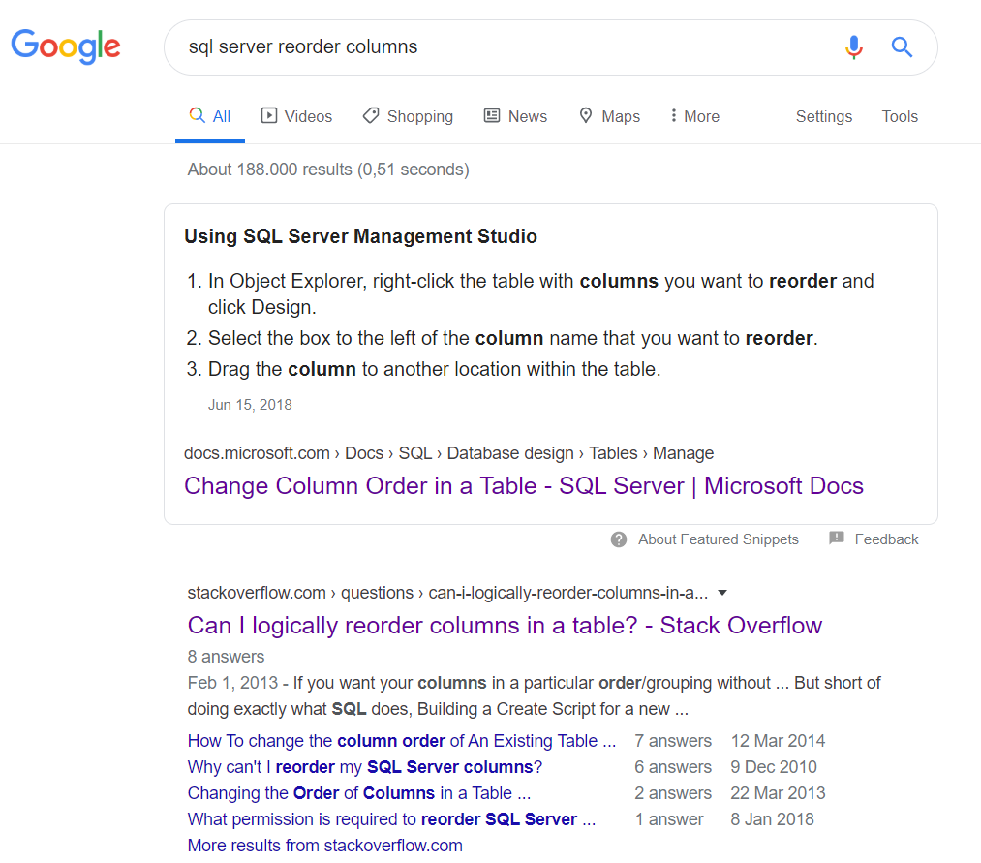
Reorder columns

Slide 39
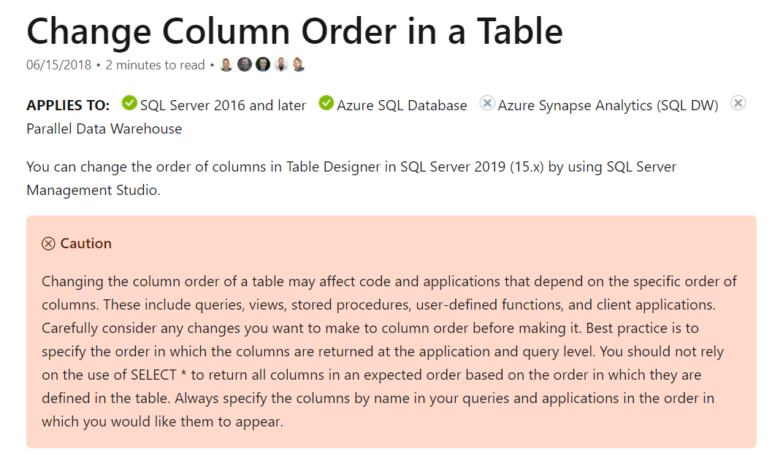
Reorder columns

Slide 40

The most important rule is

Slide 41
Todays domain Todays back-end Yesterdays database

Slide 42
Q/A

